Slide 1
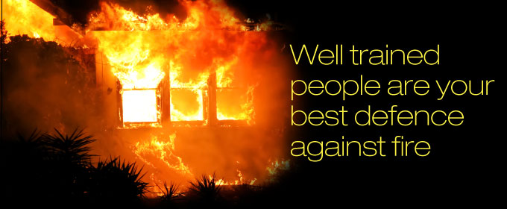
Fire Safety

Slide 2
Attitudes and Education shape the way most Canadians think about Fire Safety.
You could even say many people don’t think about it at all.
ATTITUDE:
It will never happen to me.
Community Safety is not my
responsibility.
I have time
to get out.
EDUCATION:
Many don’t understand fire realities.
Fire safe behaviours have not been learned and
put into practice.

Slide 4
What does this mean to you?
NOT ONLY CAN IT HAPPEN BUT IT CAN HAPPEN VERYFAST!!!!!
Homes and materials are NOT built/made
the way they used to be.
Changing Attitudes and Educating yourself and your family can save lives.
There’s NO TIME to waste in getting FIRE SAFE!
Let’s look at how we can STOP a fire from
happening to begin with.

Slide 5
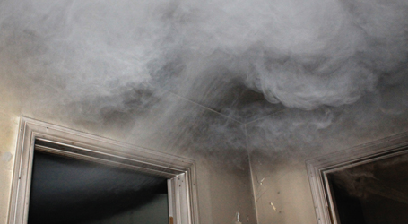
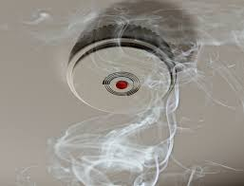
Smoke Alarms
FACT: Most fatal home fires happen at night.
The smell of smoke may not wake you.
Fires produce smoke and poisonous gas. Often this is the cause of death NOT burning.
A smoke alarm is an early warning that can give you the minutes you need to escape.
REMEMBER you may ONLY have a couple of minutes.
Having WORKING smoke alarms
reduces your risk of dying in HALF!

Slide 6
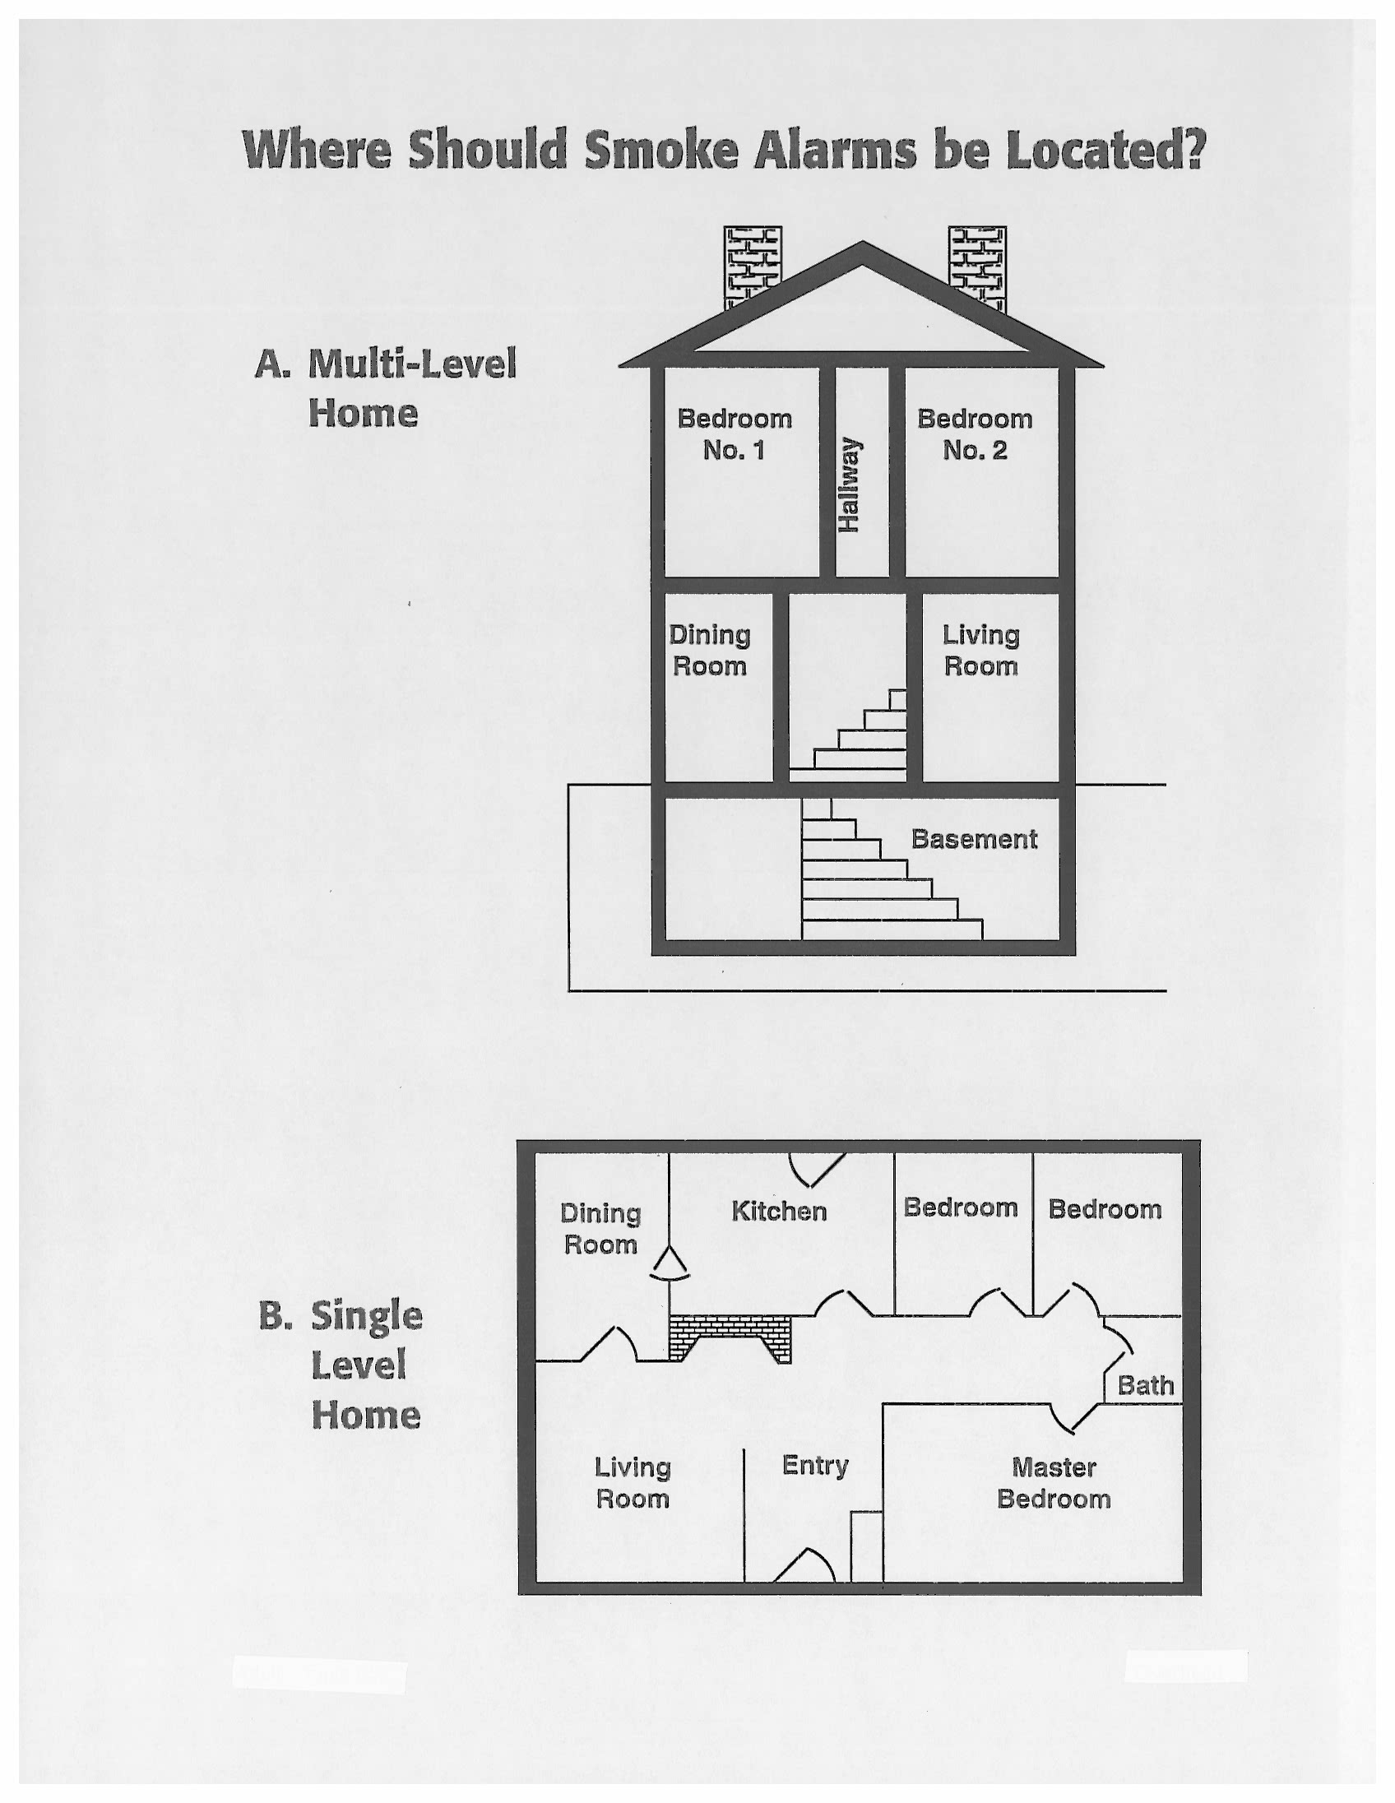
Where should they go?
Smoke alarms should be placed on each level of your home.
Outside all sleeping areas.
For added protection, in the bedrooms.
Especially for children.
Check the battery once a month and replace the battery at least once a year. Replace your smoke alarm every 10 years.

Slide 7
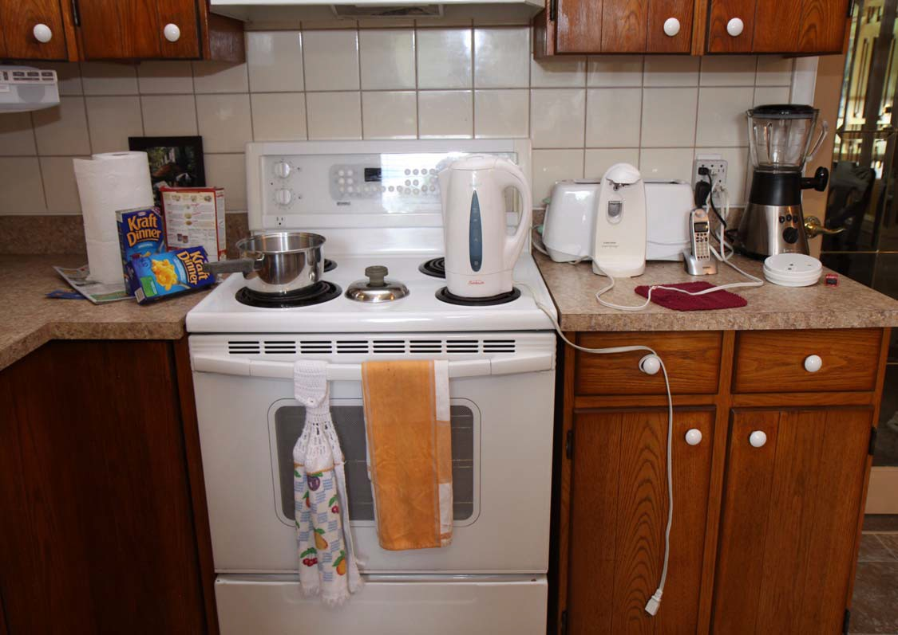
Cooking Safety Cooking is the #1 cause of Home Fires in Canada!
Can you spot some Kitchen Hazards?

Slide 8
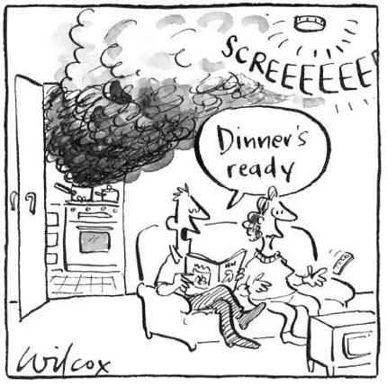
Kitchen Safety Tips.....
Keep pot handles turned in.
Clear the clutter.
Keep cords neatly wrapped.
One appliance in an outlet. Unplug when not in use.
NEVER LEAVE! Look while you COOK! Oil and fat can ignite.
Wear fitted clothing OR roll up your sleeves.
If a pot catches fire, carefully cover it with a lid and turn off the stove.
The kitchen is not a playground. Kids need to stay a safe distance away.
If it can burn keep it AWAY from the stovetop.
Don’t let this be your home.

Slide 9
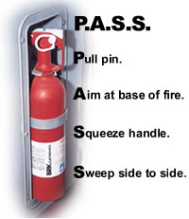
Fire Extinguishers
A portable fire extinguisher can be an effective tool in saving lives and property.
Keep one near the kitchen and KNOW when to use it and how to use it.

Slide 10
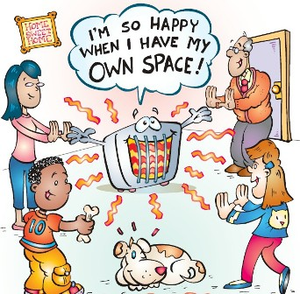
Heating
Keep anything that can burn
at least 1 meter (3 feet) from a
heat source.
Never use your oven to heat your home.
Turn heaters off when not in use.

Slide 11
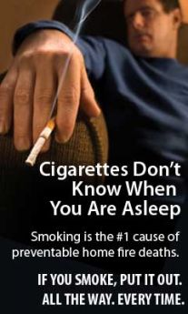
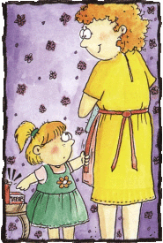
Smoking
Never smoke in bed or when you
are sleepy.
Use a deep, sturdy ashtray. Smoke outside.
Never leave matches and lighters in sight of children.
Teach children to tell you if they find matches or lighters.

Slide 12
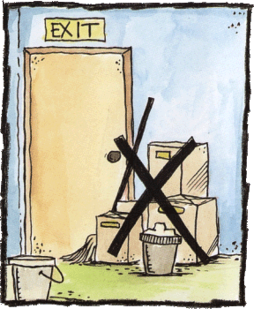
Housekeeping
Make sure your two ways out
are accessible.
Keep EXIT paths clutter free.
Remove potential hazards from your home such as paints, solvents or excessive papers.

Slide 13
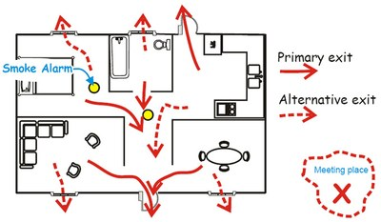
Home Fire Escape Plan
HAVE A PLAN!
Fires can happen even if you are fire smart. In the event of a fire there is NO TIME to think you must KNOW what to do!
Create a Home Fire Escape Plan with your family. Show 2 ways out
and a meeting place.
PRACTICE IT!

Slide 14
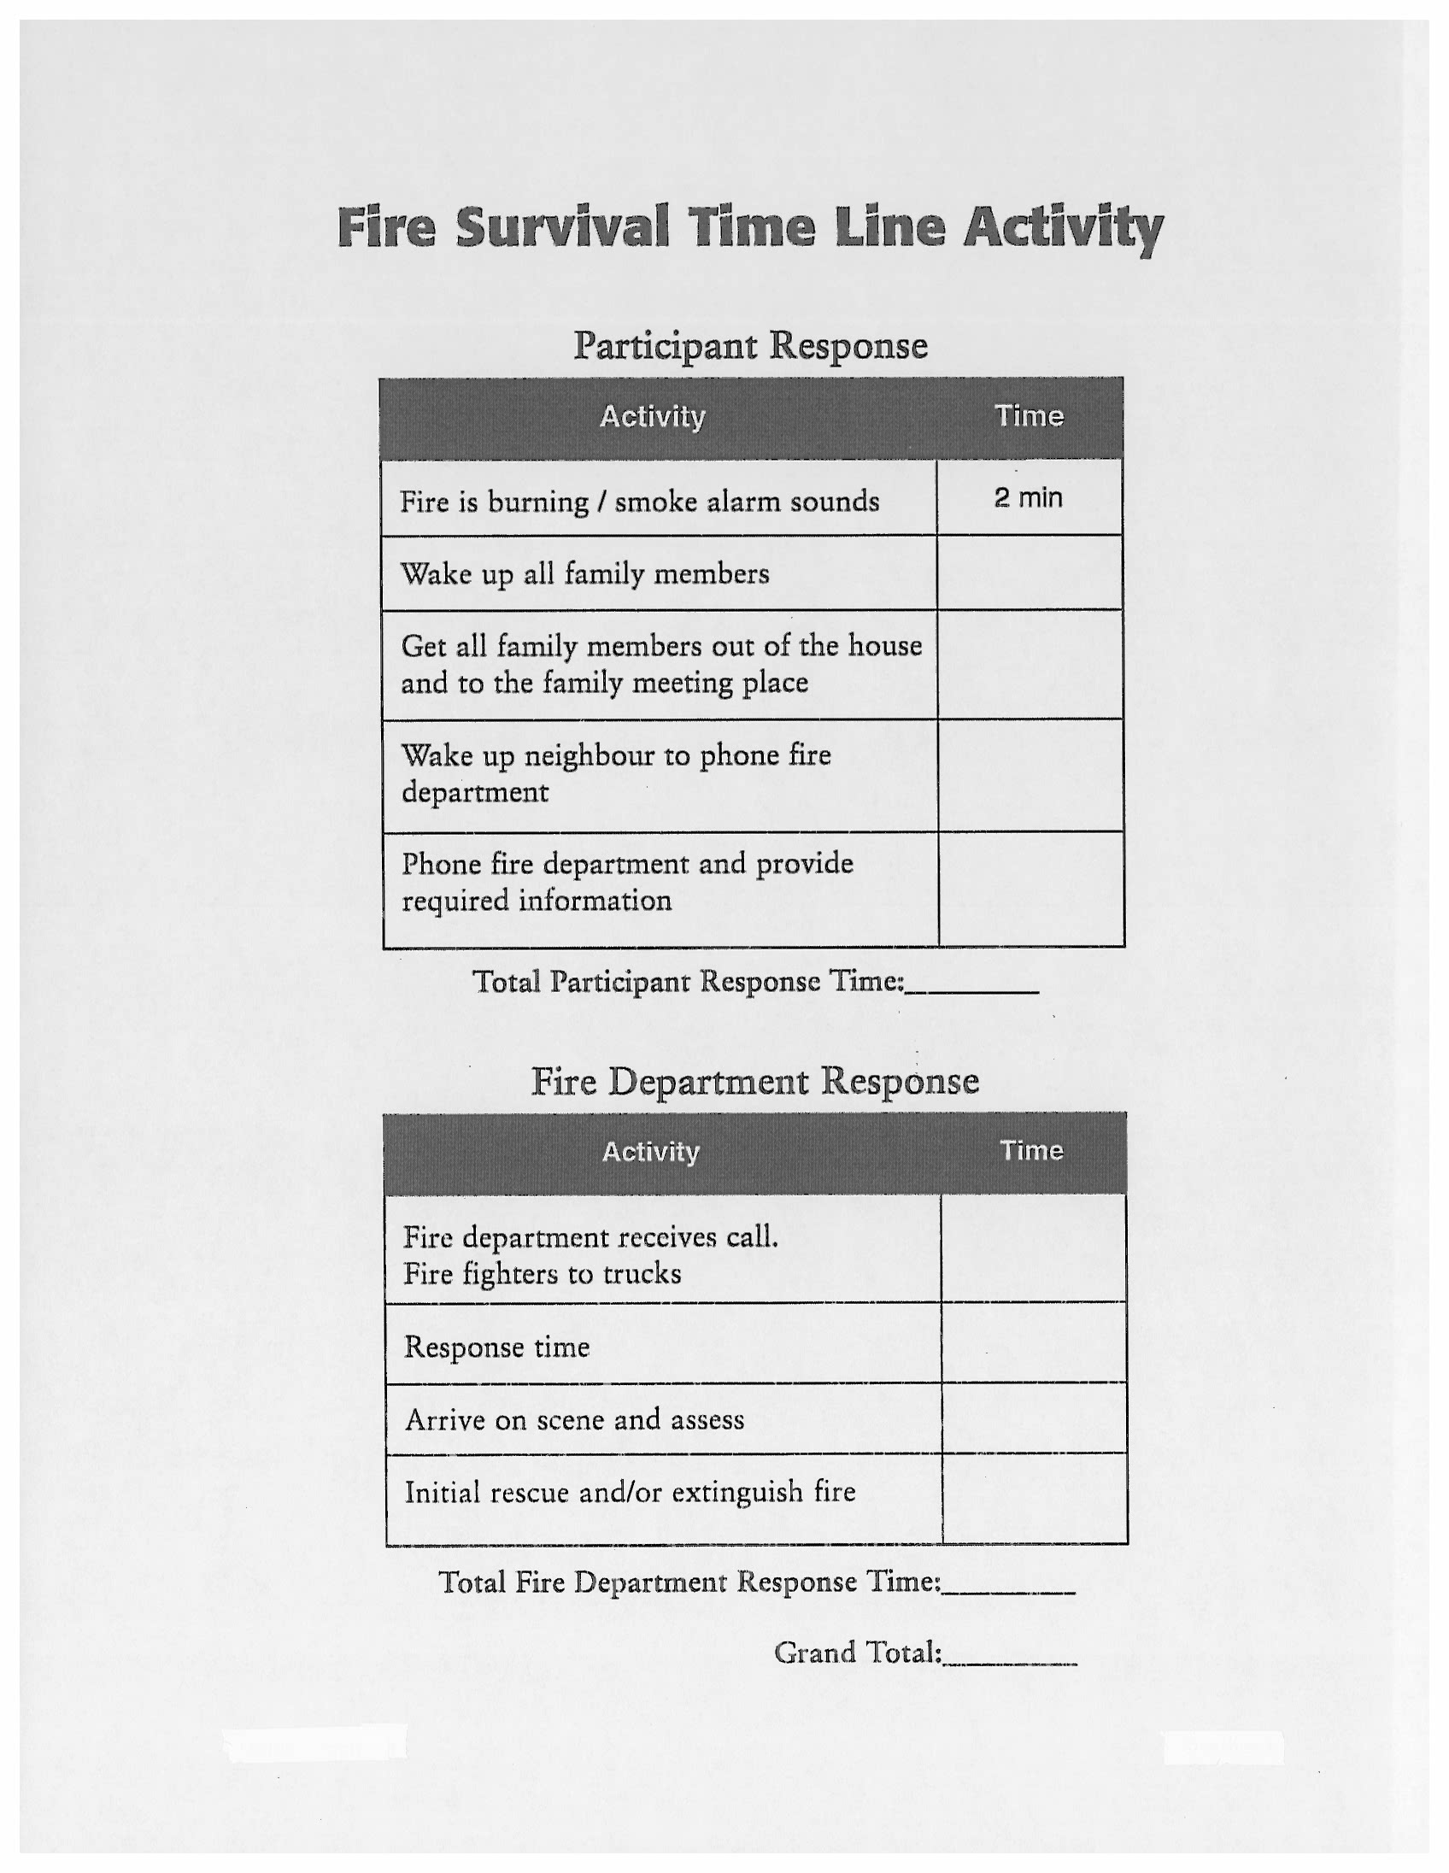
Given what you now know about how quickly you can lose your home or your life to fire, let’s look at a
Time Line Activity.
It’s 2am, a fire breaks out in your home.
It has been burning for 2 minutes. Your smoke alarm goes off.
How long will each activity take you to complete?
Remember Fire Department response time doesn’t begin until after your time ends.

Slide 15
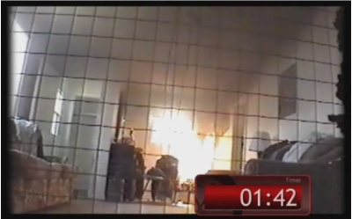
Total the 2 times (Fire Department Response time will vary) What is the condition of your home? What is your chance of survival at this time? THE FIRST THREE MINUTES ARE CRITICAL! You have an impact on your survival.

Slide 16
How Fire Safe are you?
The Fire Department needs your help.
Sharing what you have learned today may save lives.
Remember Fire Safety is everyone’s responsibility.
I hope this presentation has helped educate you and change your attitude about FIRE.......keeping you
FIRE SAFE!
Thank you, any questions?

